Slide 1
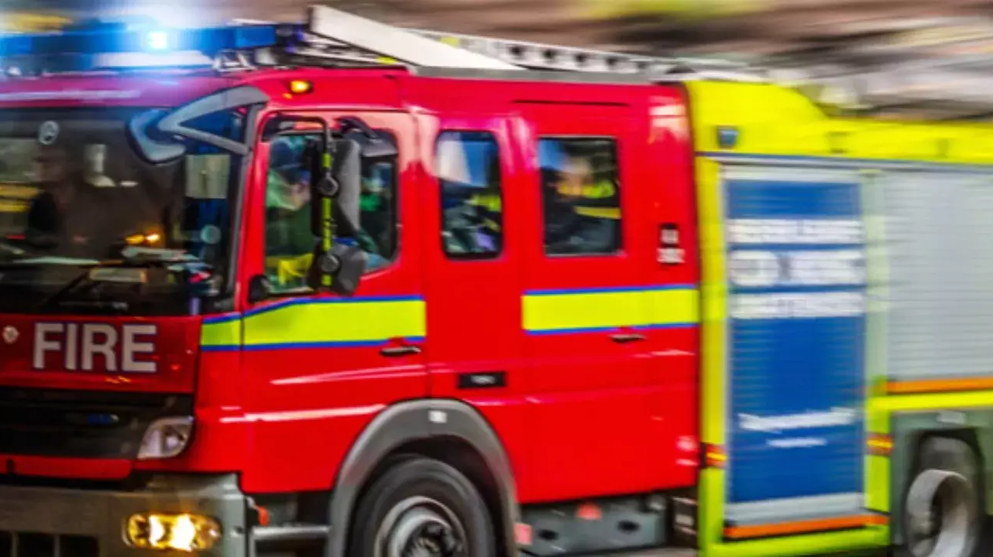
Animal Rescues by London Fire Brigade A Data Science Perspective
Anil Gangolli (Feb 2024)
Notes:
Hello everyone. Today, I’ll be looking at Animal Rescues undertaken by the London Fire Brigade - and hope to analyze and add a Data Science-based perspective.
Next slide

Slide 2
Agenda
Introduction
Why this topic
The LFB dataset
Initial Questions and Analysis
Hypotheses
Feature Selections and Modelling
Future Focus
Recommendations
Q&A
Appendix
Notes:
I’ve tried to write this presentation to cater to multiple personas - everyone in my data science cohort, to someone who is reading this for the first time. Next slide.

Slide 3
A word of warning…
The next slide may be a bit distressing or triggering for some…
Notes:
As we begin, a quick note that the next slide may be disturbing..
Next slide

Slide 4
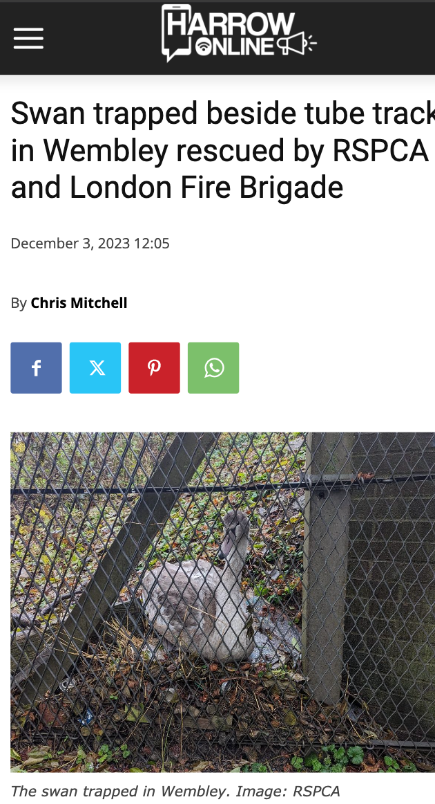
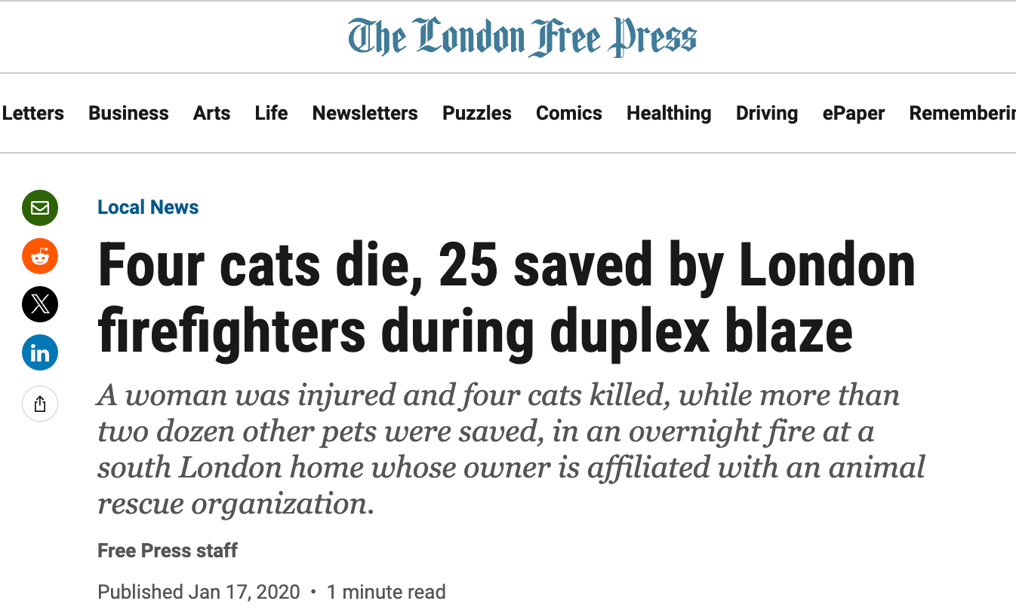
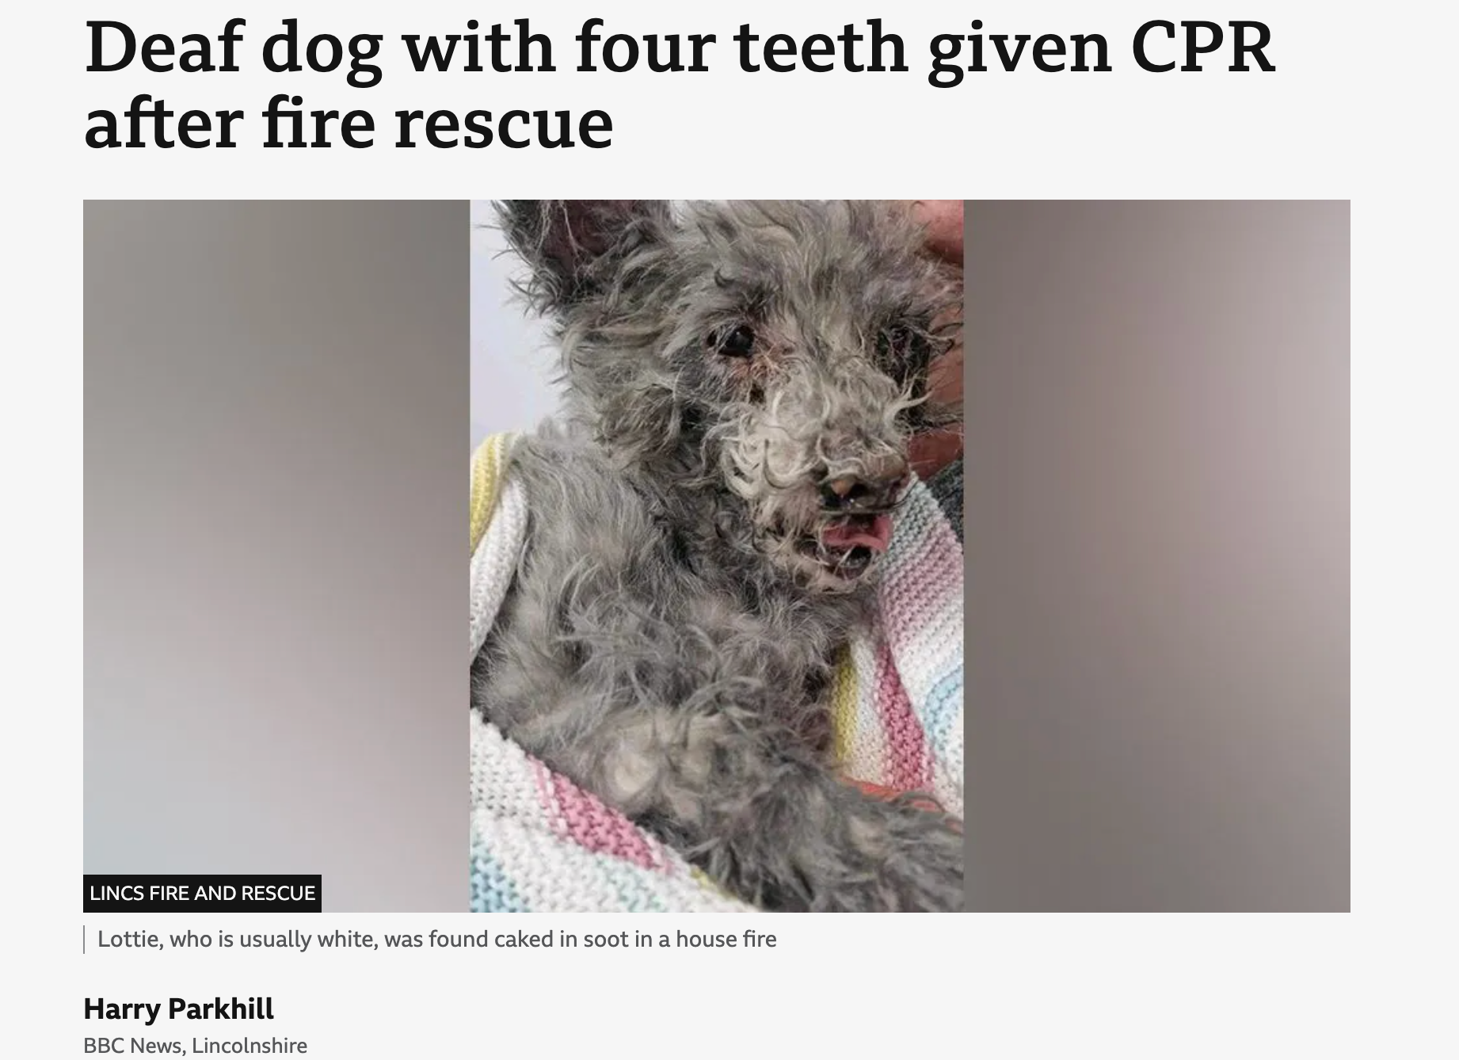
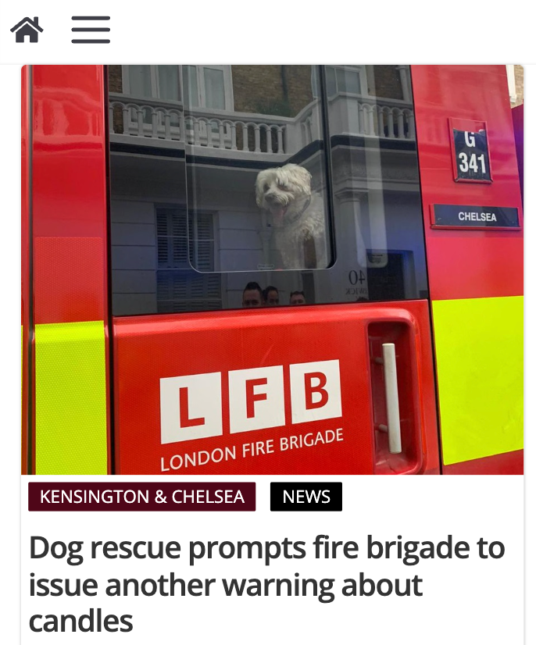
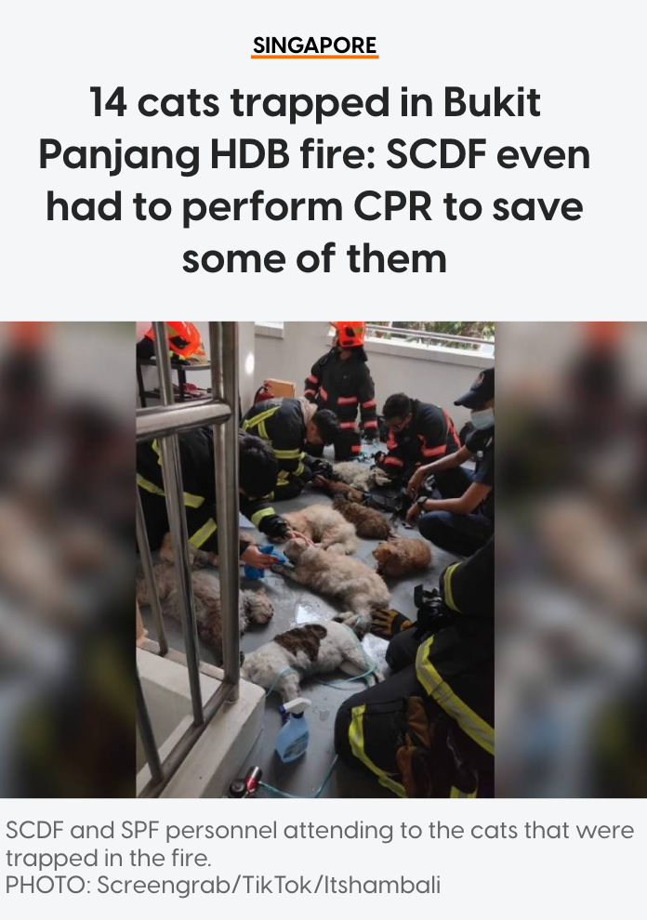
Notes:
The last image is actually from Singapore a year or so ago..
The point of the slide is to not shock you, but for you to takeaway that the fire services are saving lives, whether human or beast..
Next slide

Slide 5
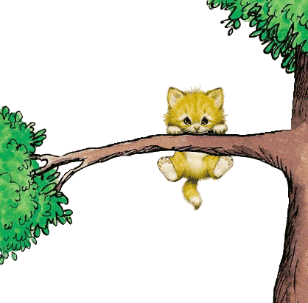



Why this topic…
Last line of help
Same but, different
Same cost & resources
Notes:
Fire Services are usually the last line of help, called in by the RSPCA / SPCA and other allied agencies
Fire and emergency services respond to animals in distress / needing rescue, with the same level of urgency and care, as humans. Rescuing animals however, involves a different set of challenges and obstacles, as compared to humans
The cost remains the same - whether for animals or humans
Finally - yes, I did have to call in the fire services once to get a pet cat down from a tall tree.. A story for another day..

Slide 6





The LFB dataset
*Link to dataset. Contains public sector information licensed under the UK Open Government Licence v3.0.
100s of Animals Rescued / yr
Logged since 2009, updated monthly
10332 rows
Includes Animal, Borough, Property type, Lat/Lon etc.
Notes:
The London Fire Brigade rescues hundreds of animals every year, from pigs, to cats, to bearded dragons and everything in between.
Animal rescues have been logged since Jan 2009 The dataset is complete till Dec 2023, and has over 10.3K records and 31 columns
The records include details such as type of animal rescued, the nature of emergency, and location records such as borough, street name etc.

Slide 7
Initial Questions
Which pincode / locale has the most number of incidents?
Are wild animal incidents found in locales near parks?
Do we see a lot more incidents after major holidays?
Do we see a higher rate of incidents near the outskirts of London?
Are response times longer for locations close to the outskirts?
Are costs higher as well?
How did these stats change over the pandemic?
Notes:
As I started working with this dataset, these were some of the questions which came in my thought process..
Next slide..

Slide 8



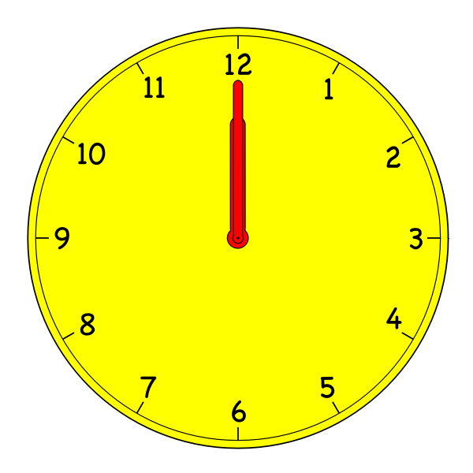
Analysis
1 in 2 Incidents involved cats
~2x rescues After Covid-19 (603 in 2019 vs 1192 in 2023)
Weekends More incidents recorded over weekends than weekdays
12 - 6 pm Most incidents recorded in 2023 (432) vs late night shift (95)
Notes:
On my initial analysis, I found…
50% of all rescues involved a cat Incidents have doubled after Covid-19 with sheltering and isolation
Incidents typically peak on weekends, and in the afternoons, and late evenings…
The data for these stats is located in the Appendix / Next few slides Next slide

Slide 9
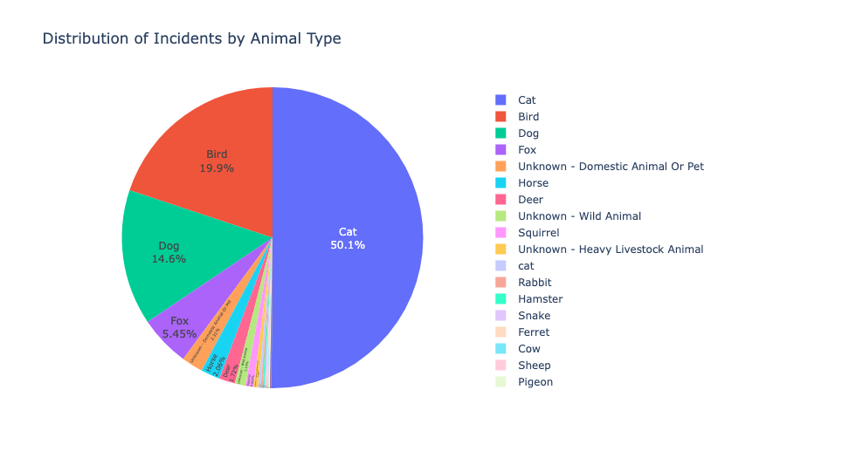
Analysis
1 in 2 Incidents involved cats

Slide 10
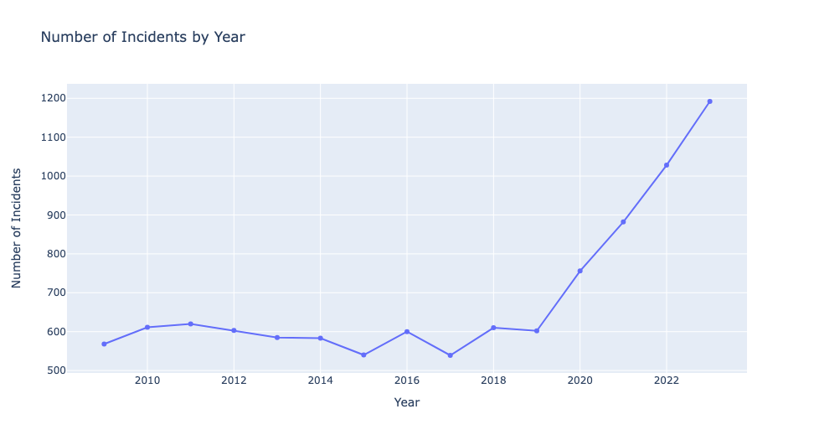
~2x cases After Covid-19 (603 in 2019 vs 1192 in 2023)

Slide 11
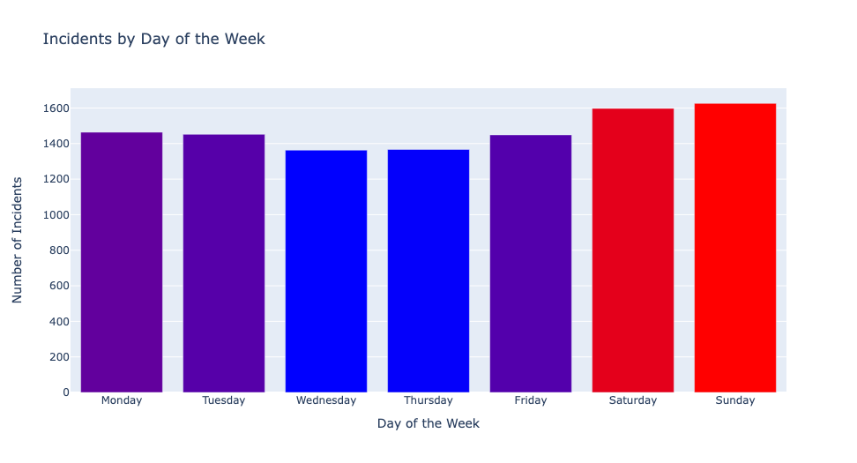
Weekends More incidents recorded over weekends than weekdays

Slide 12
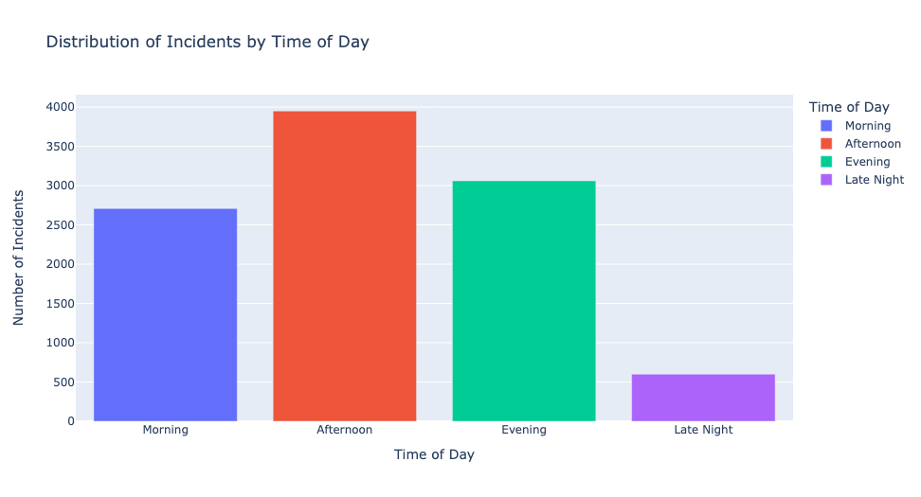
12 - 6 pm Most incidents recorded in 2023 (420) vs late night shift (95)

Slide 13
Hypotheses
It is possible to predict the species of animal affected based on factors such as location, property type or other factors. (KNN)*
It is possible to forecast time periods / dates when incidents will spike due to seasonality, trends or other external factors. (Time-Series)
Based on past rescue descriptions, it is possible to identify similar patterns across incidents, and help to identify opportunities for prevention or remediation. (NLP)
*Common Data Science terms explained in the Appendix
Notes:
After all that analysis, some of my initial questions were answered. This helped to solidify and clarify some questions to deliberate hypotheses
(summarize the 3 points) For this presentation, we’ll focus on KNN Next slide

Slide 14
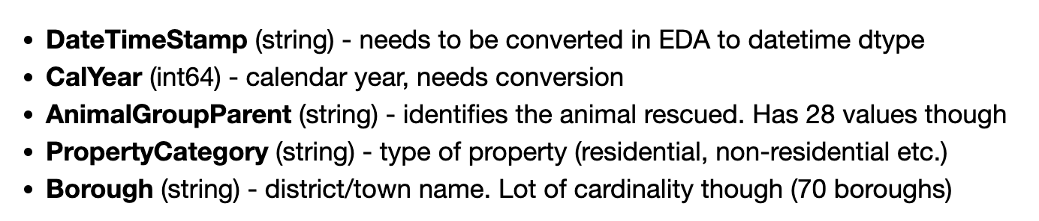
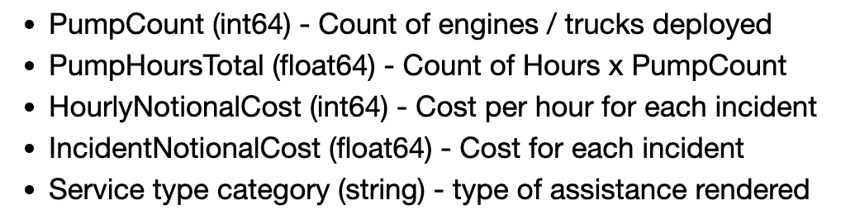
Data columns included in Dataset

Slide 15
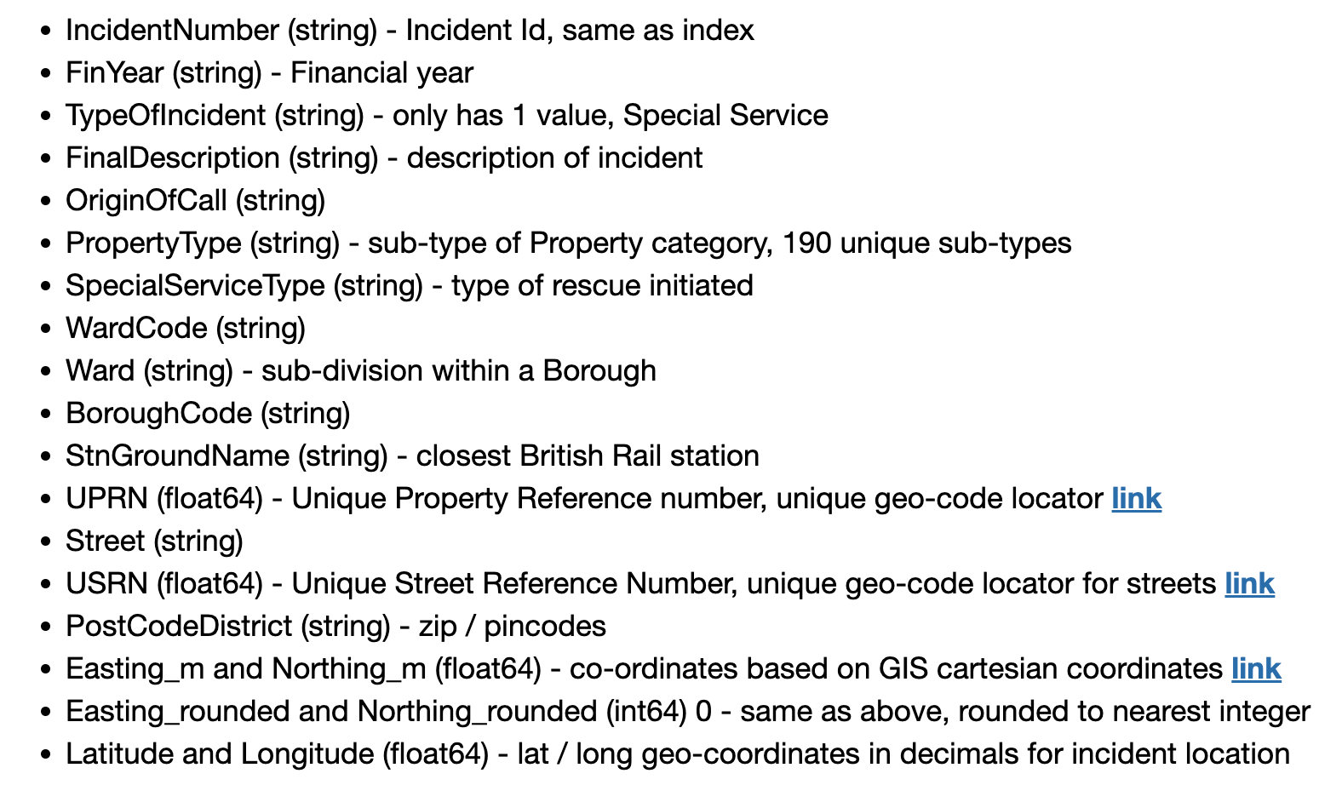
Data columns included (contd.)

Slide 16
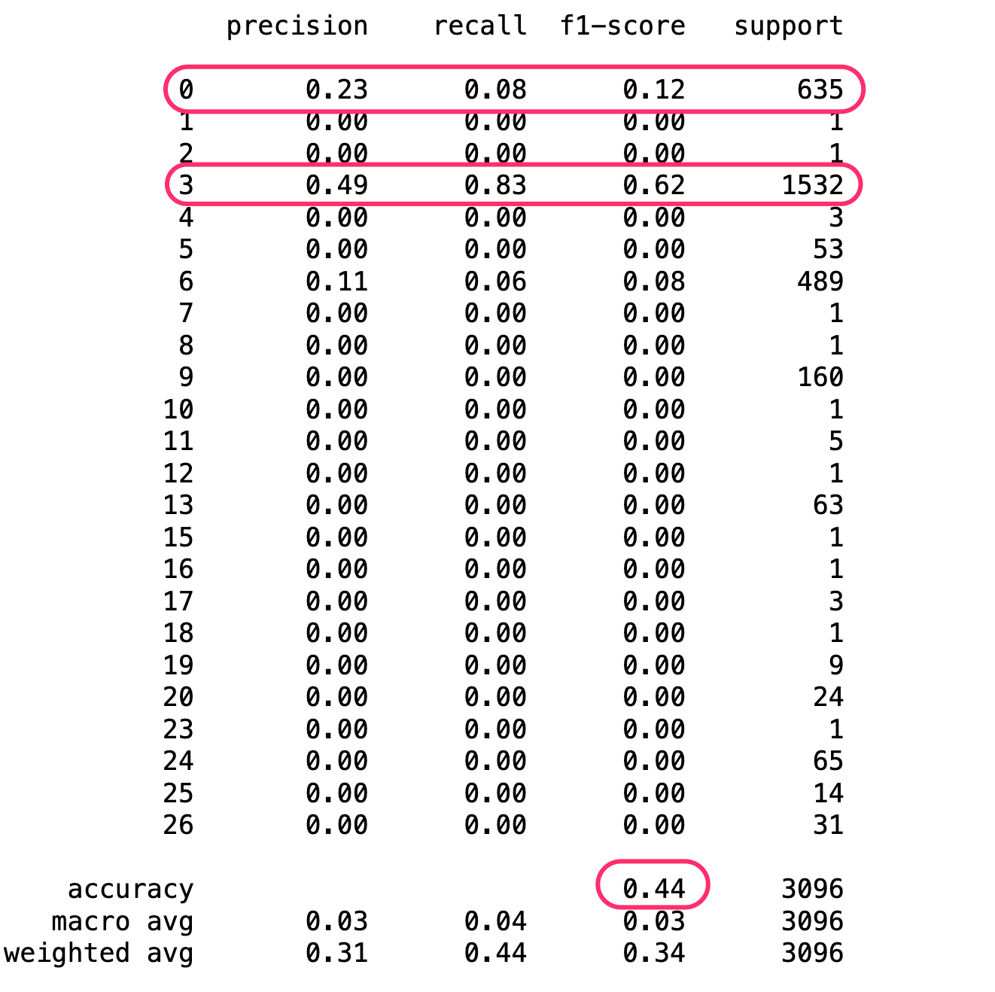
Feature & Model selection
The dataset has a lot of descriptive records, as compared to numeric values
I chose K-Nearest Neighbour or KNN, for our modeling and predictive analysis
Initial try - Month as Feature, Animal as Target
Accuracy at 44%, but recall only good for a single animal (3 = Cat)
Notes:
To utilize KNN, I needed to choose our Feature variables, with the Target as Animal For the first iteration, and Month as the feature, the model didn’t make a lot of sense. Next slide

Slide 17
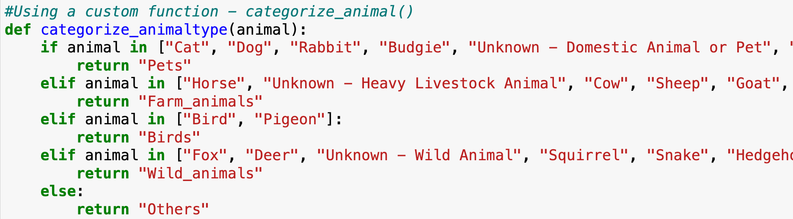
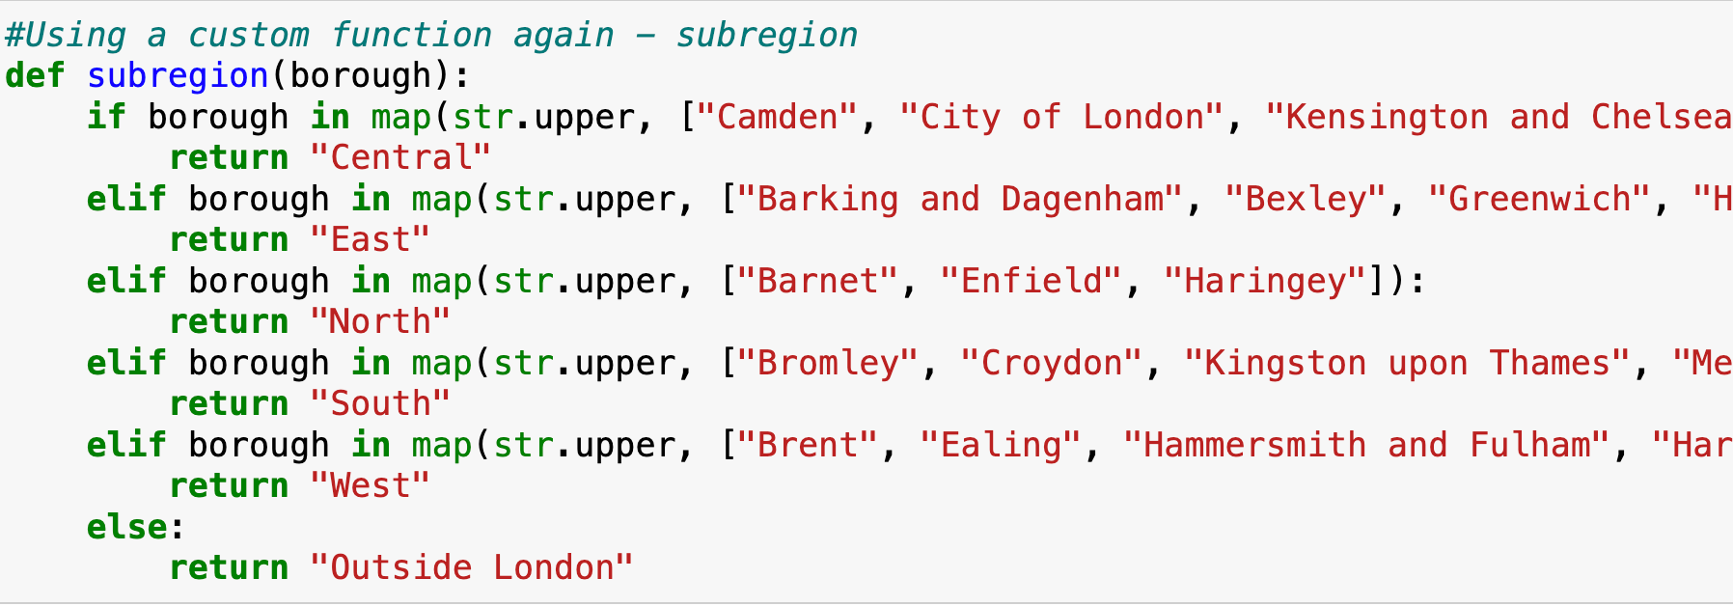
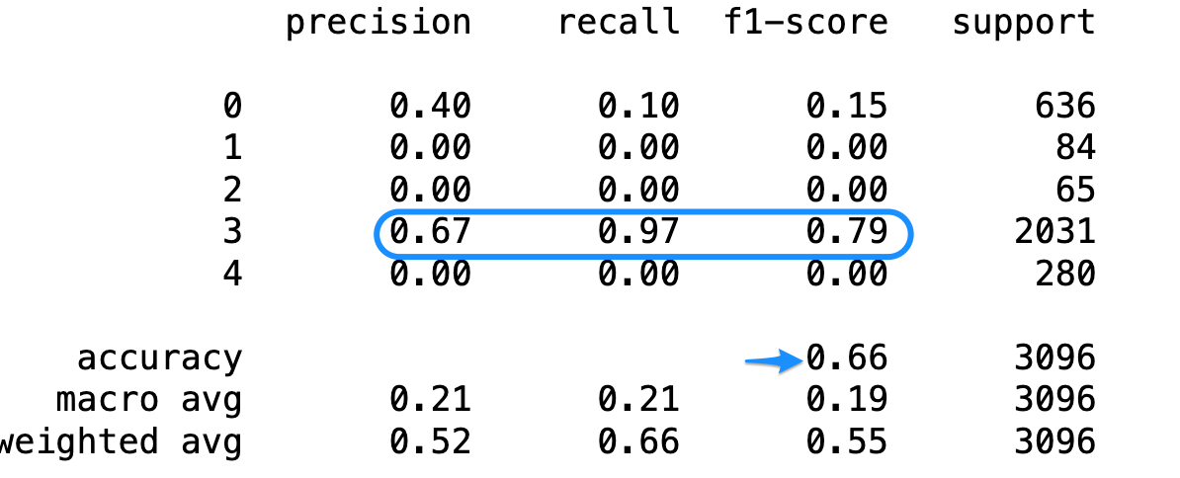
Animals grouped into categories such as Pets, Wild Animals, Birds, Fish etc.
Dropped Month, and chose PropertyType and Boroughs as features
Boroughs grouped into Sub-regions of London
Overall accuracy improved to 67%, with good f1 (0.79) and recall (0.97) for Pets
Notes:
To simplify the model, I then chose to group the animals, into Pets, Wild Animals etc.
I also chose to group Boroughs into SubRegions to add it as a Feature.
I used custom functions to simplify both groups. The new model did marginally better, with better f1 and recall scores
Next slide

Slide 18
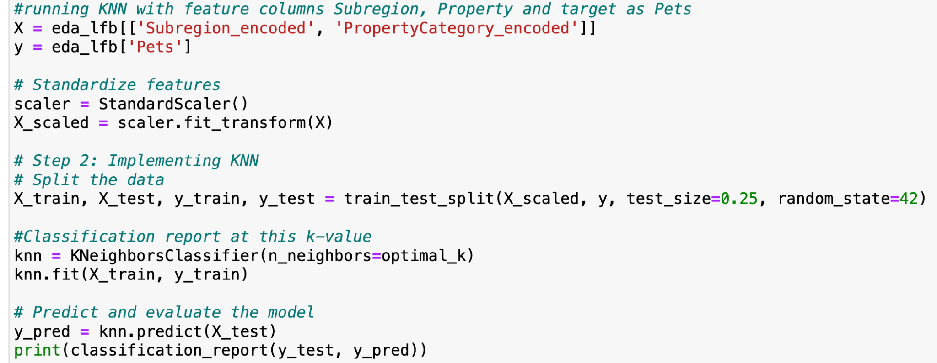
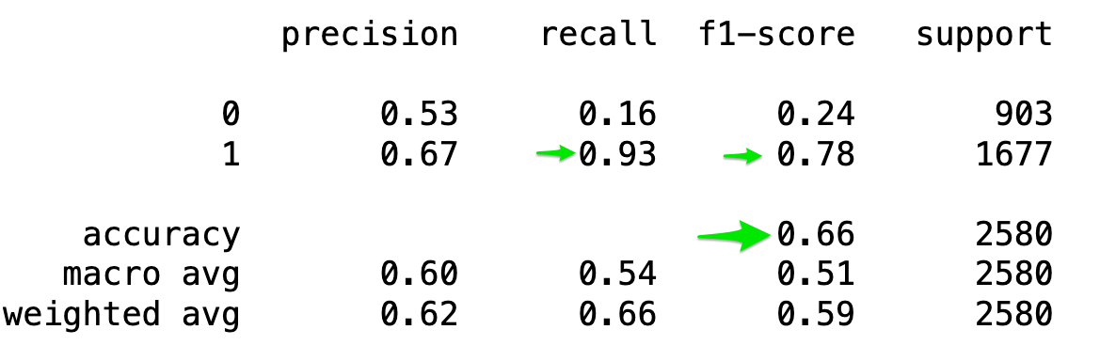
Final iteration - predict if the animal involved is a Pet or not (Non-Pets)
Feature columns - PropertyCategory and SubRegion
Accuracy at 66% with slightly better precision for Non-Pets at 0.53.
Notes:
For my last iteration, I further simplified the groups into Pets and Non-Pets.
This helped to get good scores and recall for Pets, but low scores for Non-Pets.
I elected to go with 5-fold crossvalidation to arrive at an optimal k-value (28)
Next slide

Slide 19
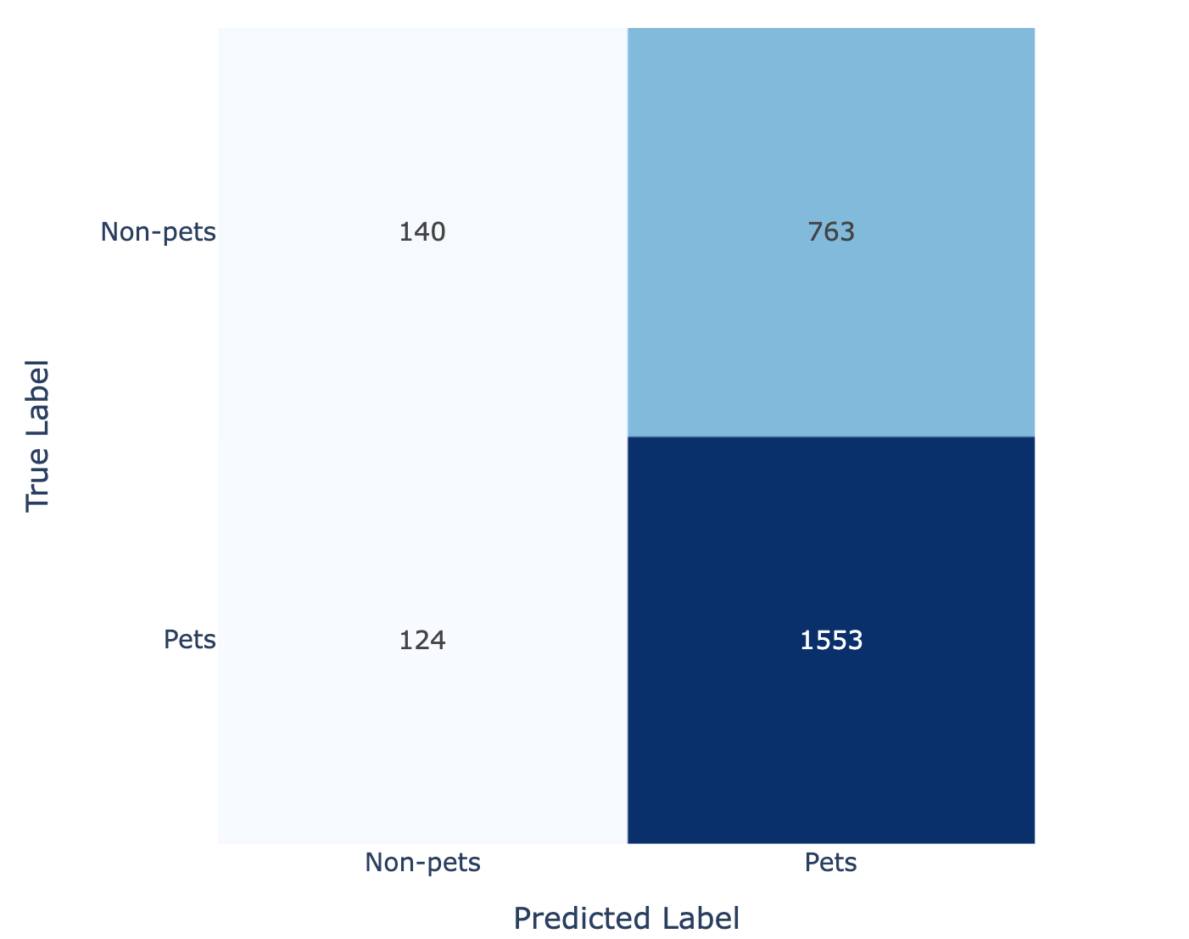
We can predict if a rescued animal is a Pet with a good deal of confidence and accuracy
However, the model is also prone to misclassifying non-Pets as Pets
Heavy bias towards Pets in animal types, is a large factor for the imbalance
The model can be probably improved and targeted to identify animals within Pets
Notes:
The confusion matrix confirmed that the model was good at identifying True Positives i.e Pets, but was throwing up a lot of False Positive errors (Non-Pets as Pets)
This can be probably improved, but I stopped at that

Slide 20
Future Focus
It is possible to predict the species of animal affected based on factors such as location, property type or other factors. (KNN) ✅ /🤔
It is possible to forecast time periods / dates when incidents will spike due to seasonality, trends or other external factors. (Time-Series) 📋
Based on past rescue descriptions, it is possible to identify similar patterns across incidents, and help to identify opportunities for prevention or remediation. (NLP)📋
Notes:
As further analysis for later, I aim to focus on the other hypotheses - using Time-Series to forecast any spikes based on previous incidents and seasonality, and working with NLP to common patterns across incidents (e.g. cats stuck on trees, hamsters caught in drains etc.)
Next Slide

Slide 21
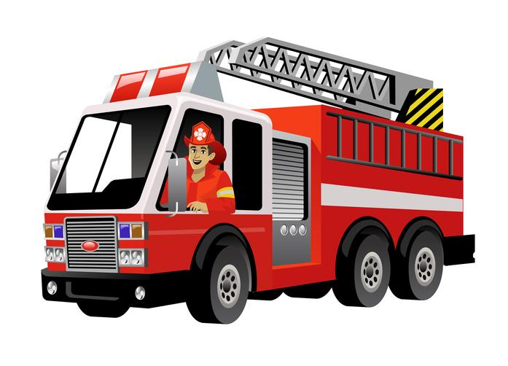



Recommendations
Specialized Training & Development
Resource Allocation & Prioritization
Community Engagement & Education
Notes:
Now, coming from the analysis and the modelling - some of the recommendations are:
Based on the type of animals rescued, firefighting teams can have specialized training to help them deal with animal emergencies better
We already know that peak times for incidents are in the 2nd part of the day, this should help to assign the right personnel and equipment available
Work with animal shelters, pet shops and educational institutions on responsible pet ownership and care
Of course, all of these recommendations will be more effective, when informed by and implemented with data analysis and science behind it.. Next slide…

Slide 22
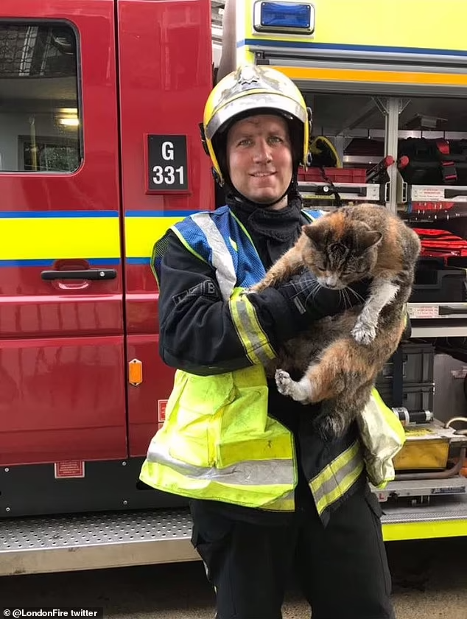
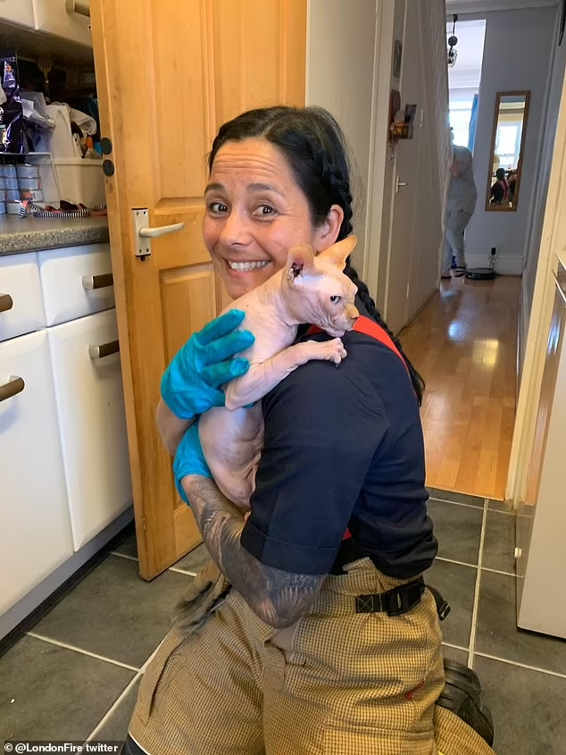
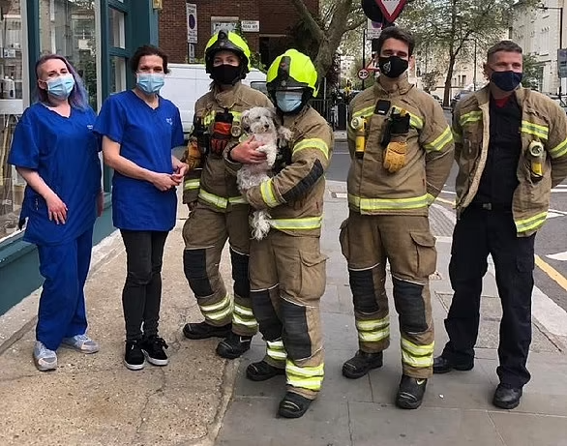
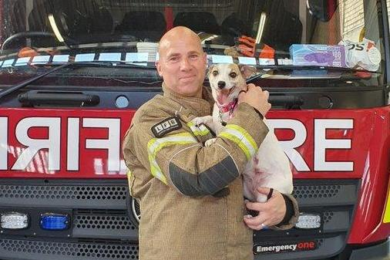
Notes:
This is the last slide before Q&A. Now, I know I started this with some disturbing images.. So, here are some happier images..

Slide 23
Q&A

Slide 24
Appendix

Slide 25
Definitions
K-Nearest Neighbours (KNN): A simple, non-parametric algorithm used for classification and regression to predict an object's classification or value based on the majority vote or average of its k-nearest neighbors
Target: The variable that the model is being trained to predict
Features: The variables which the model is being trained on, to predict the Target
Precision: Indicates the accuracy of positive predictions. Or how correct is this predicted value?
Recall: Measures how well the model can find all the positive samples.
F1-score: A weighted average of precision and recall.
Support: The actual number of occurrences of each group in the dataset.
Accuracy: The proportion of total predictions that were correct - usually expressed in percentage.

